Slide 1
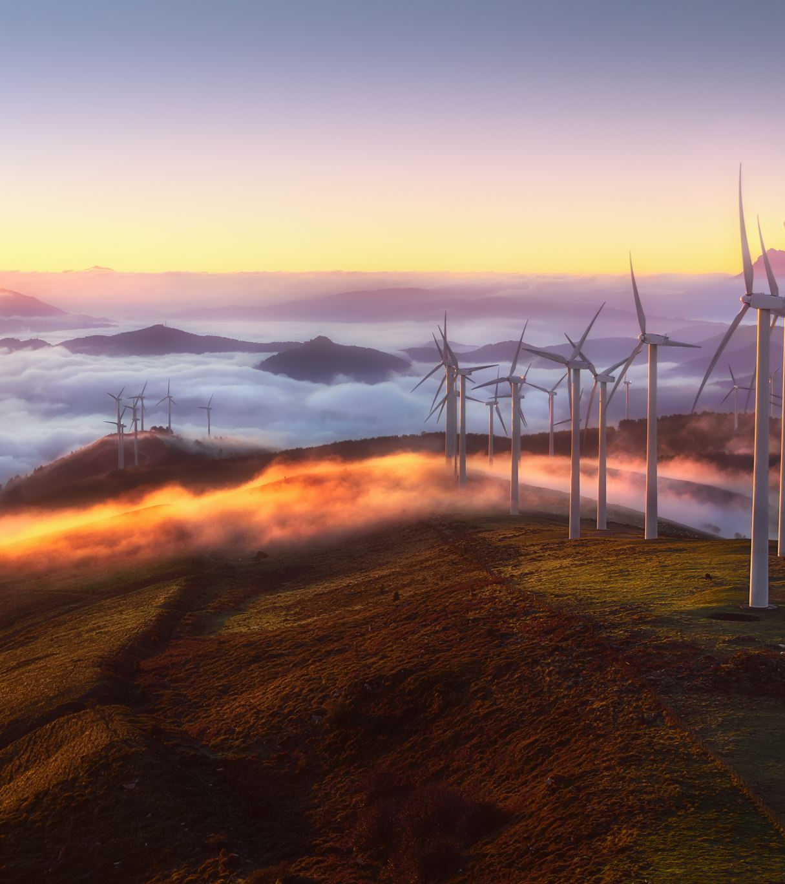
Free Energy! A Dream Come True
By:
Navjeet Kaur
2316574
Notes:
I m here to present the findings of an interesting project that I have been working on from past 3 months. In the situation are in today anything free seems impossible.I can assure that with the research that I have preformed Free energy can be a reality for the people of brighton

Slide 2

Objectives
Provide a new service by which local clients that are near a source of renewable energy will have free energy when there is a surplus of energy in that area.
Create a reliable system that can predict the surplus energy at least 24 hours in advance about
Send alerts to the customer to allow them to opt-in to the slot for free energy
Deal with situations when the predictions go for a toss and prevent loss to the company
Notes:
Main Objective of the Project were to

Slide 3
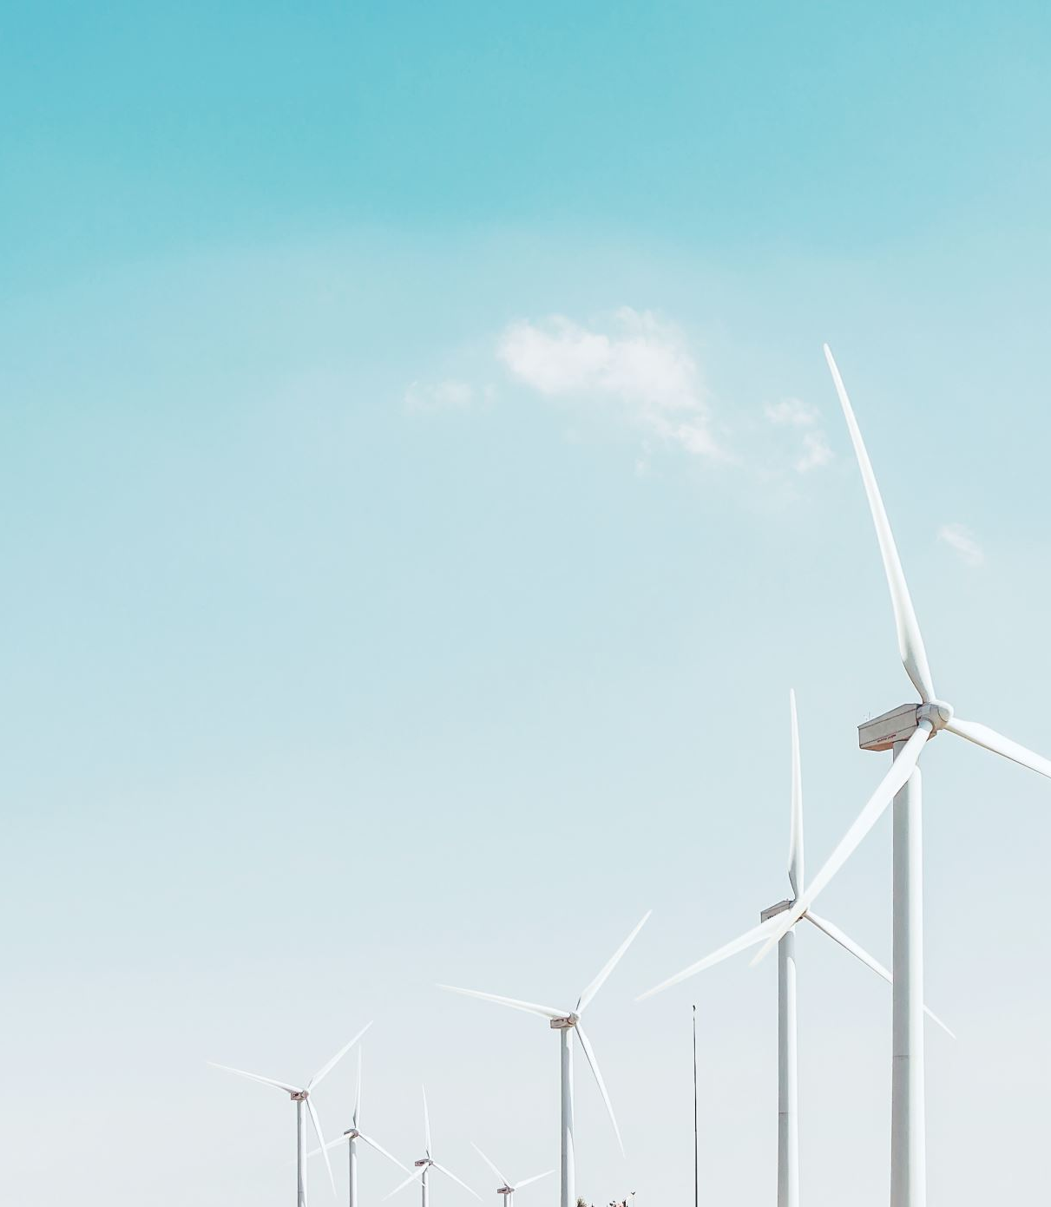
Sources of Renewable Energy for our company
Solar Energy:
Solar energy is obtained from the sun's radiation. It can be captured using photovoltaic (PV) cells to produce electricity or solar thermal systems to generate heat. Solar energy is abundant and widely available.
Wind Energy:
Wind energy is harnessed from the kinetic energy of wind. Wind turbines convert wind energy into electricity, which can be used to power homes, businesses, and industries. Wind farms are often located in areas with strong, consistent winds.

Slide 4
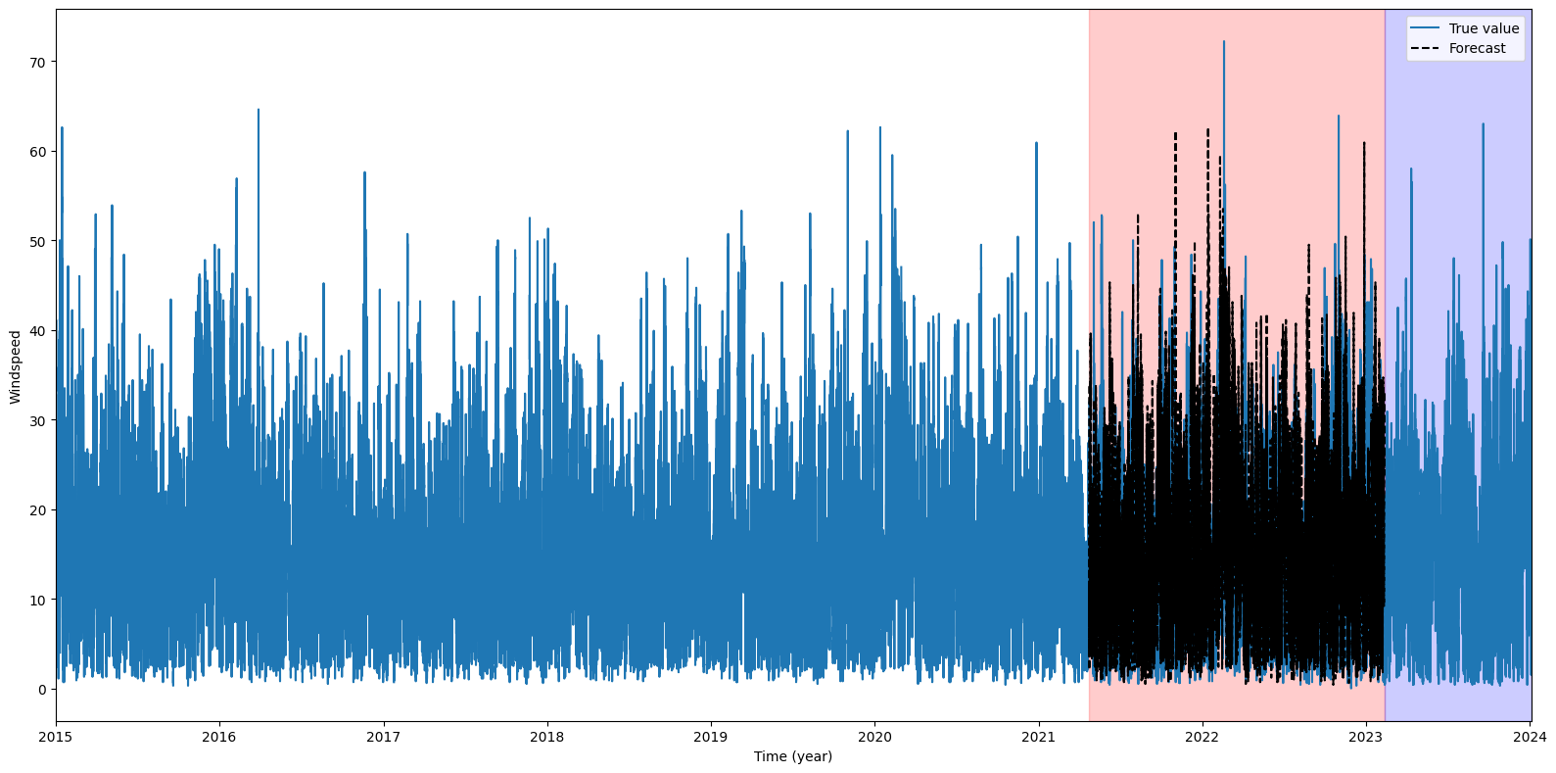
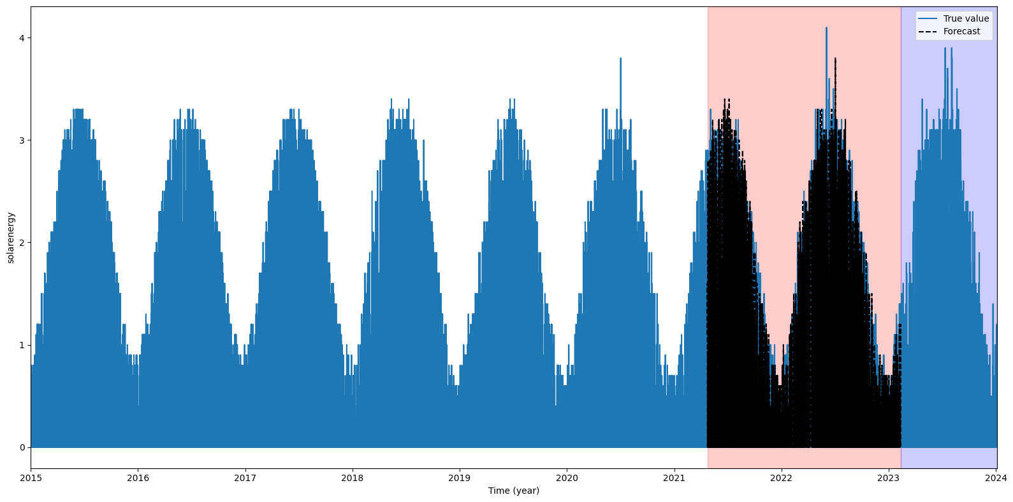
Data has something to share
Wind Speed and Solar Energy have a repetitive behavior over the years

Slide 5
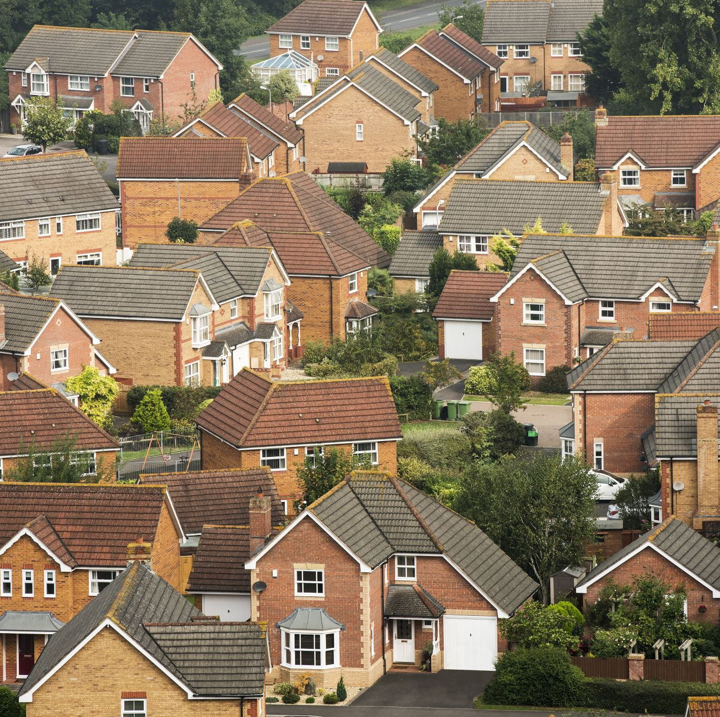

Surplus Energy Over the years
4686 hours where we had 4 times surplus energy throughout 2015 to 2023. Considering Energy Consumption Per Hour 41666.66 KHW for 100000 houses in Brighton.

Slide 6
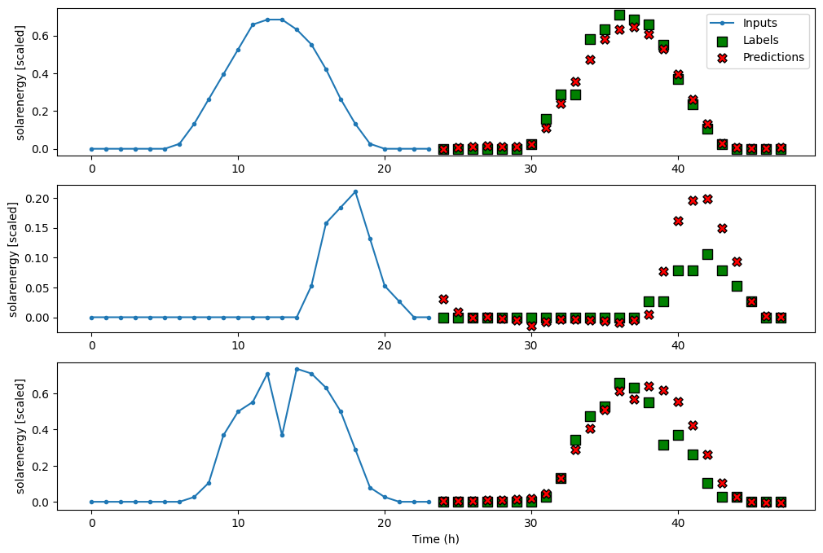
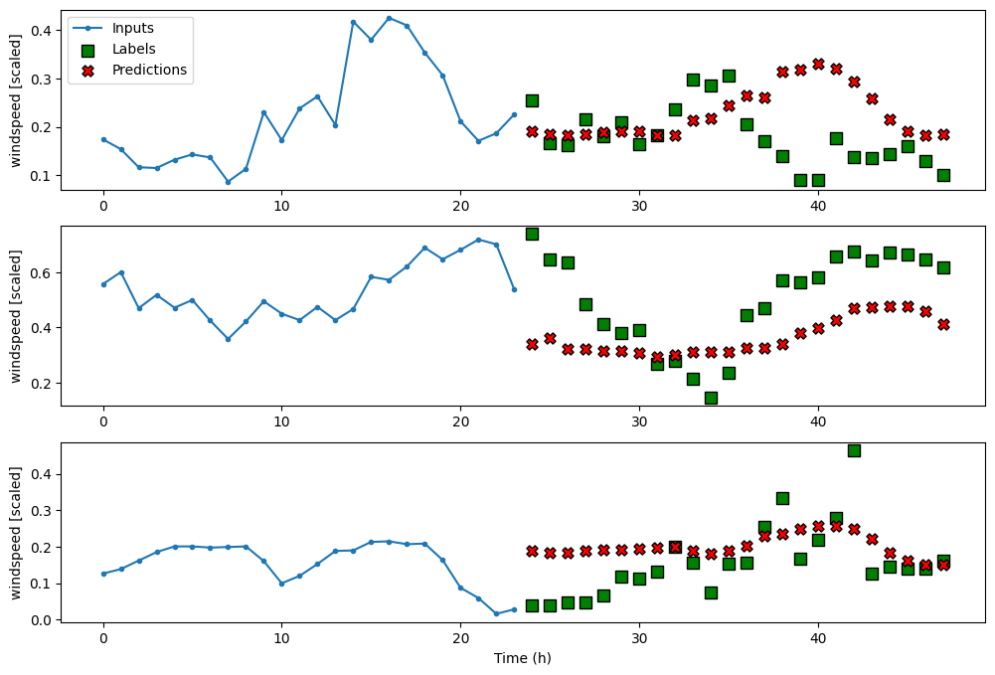
Predictive Analysis
Interesting findings from the historical Data motivated to perform a Predictive analysis of the features. Some interesting facts are mentioned below:

Slide 7
Future Holds Hope
From the Extensive study of the past and future, hopefully, the company will be able to provide Free Energy to the customers under the assumption:
The Future doesn’t have unforeseen circumstances such as a pandemic
A sudden change in the population or climate of the City

